Slide 1
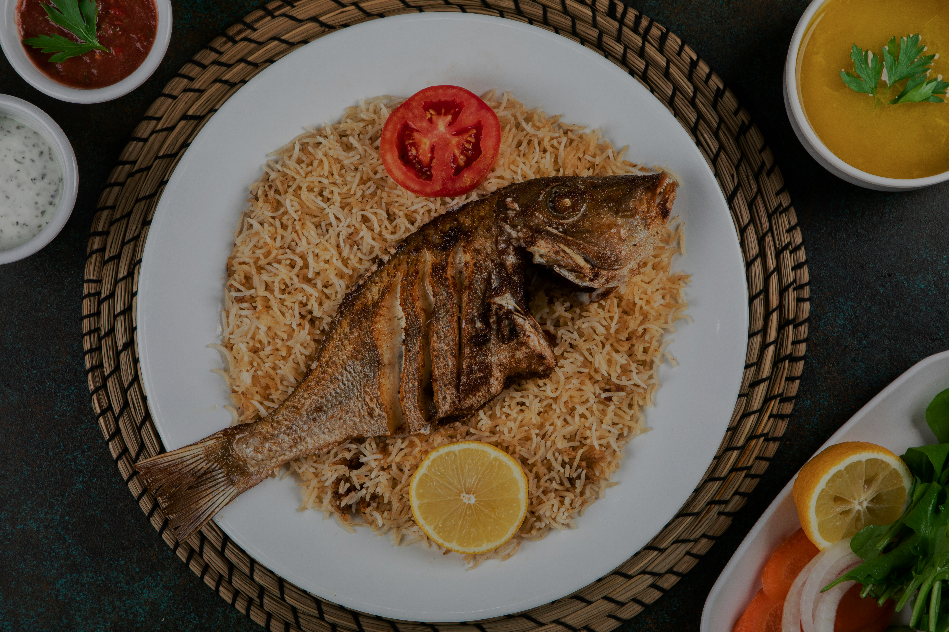
MEALMATE
Project Presentation
Team – 05
Iresh Issarsing – Team Manager
Nikhil Shibu – Tech Lead
Ryan Lush – Documentation Lead

Slide 2
Setting the Stage: An Overview
Meal planning and tracking nutrition can be challenging, especially for students living independently. To address this issue, we propose MealMate, a Java-based GUI application. MealMate aims to simplify meal planning, track macronutrients, and facilitate grocery management. By providing features such as recipe organization, meal planning, grocery list generation, and nutritional intake monitoring, MealMate aims to empower users to make informed dietary choices and develop healthier eating habits.

Slide 3

Scope of the Project
MealMate aims to address the specific challenges faced by students in managing their meals effectively while living on their own by:
allowing students to easily create and store recipes, including details such as ingredients, quantities, serving sizes, and nutritional information.
enables students to plan their meals for the week by selecting recipes from their library and scheduling them on a calendar interface.
Allows them to track their daily nutritional intake by comparing their actual consumption against preset targets or customizable goals.

Slide 4
Scope of the Project
MealMate aims to address the specific challenges faced by students in managing their meals effectively while living on their own by:
allowing students to easily create and store recipes, including details such as ingredients, quantities, serving sizes, and nutritional information.
enables students to plan their meals for the week by selecting recipes from their library and scheduling them on a calendar interface.
Allows them to track their daily nutritional intake by comparing their actual consumption against preset targets or customizable goals.

Slide 5
Architectural Design
MealMate is designed as a Java-based GUI application structured around modular components for user management, recipe management, meal planning, and nutritional tracking. Initially, the application utilizes a file-based storage system, such as CSV, for data storage, with potential for integration with an SQL database in the future. The user interface offers intuitive navigation, featuring screens for registration, login, recipe management, meal planning, grocery list generation, and nutritional tracking.

Slide 6
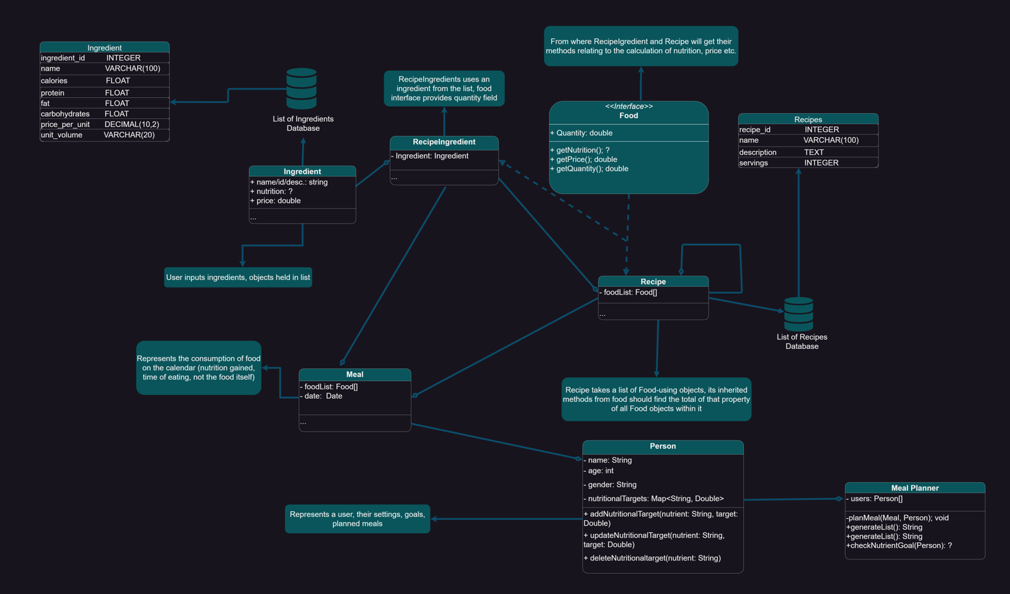
Detailed Design

Slide 7
User Interface:
The user interface is designed using JavaFX, ensuring compatibility across different platforms and devices.
Data Storage:
MealMate utilizes a file-based storage system (e.g., CSV, TXT) for storing recipe information, scheduled meals, and nutritional data.

Slide 8
Core Functionalities:
Recipe Management: Users can create, view, update, and delete recipes through a dedicated interface.
Meal Planning: Meal planning is facilitated through a calendar interface, where users can schedule meals for each day of the week.
Grocery List Generation: MealMate automatically generates a grocery list containing all the required ingredients, quantities, and estimated prices.
Nutritional Tracking: The application calculates the nutritional information for each recipe based on its ingredients.

Slide 9
Algorithms
Meal Planning Algorithm:
function calculateMealNutrition(recipeList, servings):
Initialize empty nutrition object
For each recipe in recipeList:
Retrieve recipe nutrition information
Scale recipe nutrition by servings
Add scaled nutrition to meal nutrition object
Return meal nutrition
Grocery List Generation Algorithm:
function generateGroceryList(mealPlan, pantryItems):
Initialize empty grocery list
For each meal in mealPlan:
For each ingredient in meal:
If ingredient not in pantryItems:
Add ingredient to grocery list
Return grocery list

Slide 10
Implementation and testing
Through rigorous testing methodologies, including unit testing, integration testing, user acceptance testing, regression testing, and performance testing, we verify the reliability, functionality, and usability of the application.
With all these testing we can guarantee that MealMate delivers a seamless and satisfying user experience, empowering students to manage their meals with ease and confidence.

Slide 11

Significance of the Project
Recipe Storage: MealMate provides a centralized database where users can input and manage their recipes, making it easy to access and reference them when planning meals.
Meal Planning: MealMate allows users to schedule meals for specific days, incorporating diverse recipes and ensuring nutritional balance by tracking macronutrient intake and portion sizes.
Nutritional Tracking: MealMate offers comprehensive nutritional tracking capabilities, enabling users to monitor their calorie, macronutrient, and micronutrient intake and adjust their diet accordingly.

Slide 12
Recipe Storage: MealMate provides a centralized database where users can input and manage their recipes, making it easy to access and reference them when planning meals.
Meal Planning: MealMate allows users to schedule meals for specific days, incorporating diverse recipes and ensuring nutritional balance by tracking macronutrient intake and portion sizes.
Nutritional Tracking: MealMate offers comprehensive nutritional tracking capabilities, enabling users to monitor their calorie, macronutrient, and micronutrient intake and adjust their diet accordingly.
Constraints:
Resource Constraints: Limited resources, including time, budget, and manpower, creates challenges during the development process.
Technical Hurdles: Developing a robust and user-friendly GUI application with complex functionalities requires overcoming various technical challenges, which includes ensuring data integrity, implementing efficient algorithms for meal planning and nutritional tracking, and optimizing performance across different devices and platforms.

Slide 13
Constraints:
Resource Constraints: Lack of time.

